Slide 1

IEEE Transactions on Intelligent Transportation Systems
Mobility and Deadline-Aware Task Scheduling Mechanism for Vehicular Edge Computing
Joahannes B. D. da Costa , Allan M. de Souza , Rodolfo I. Meneguette , Eduardo Cerqueira , Denis Rosário , Christoph Sommer , and Leandro Villas
Team 25

Slide 2

Introduction
The rise of autonomous and connected vehicles is driving demand for low-latency, real-time services.
Applications such as autonomous driving, real-time object detection, AI learning, etc., require high computation power on the move.
Traditional cloud computing is not viable due to network delays and bandwidth bottlenecks.
Vehicular Edge Computing (VEC) brings computation closer to vehicles using edge nodes like roadside units (RSUs), base stations (BS), and even vehicles themselves.
This leads to the formation of Vehicular Clouds (VCs) that share computing and storage.

Slide 3

Problem Statement:
Vehicular Edge Computing (VEC) systems must handle low-latency, mobility-sensitive task scheduling across dynamically available Vehicular Cloud (VC) resources. However, efficiently deciding where and when to execute tasks
Considering ,
task deadlines
node mobility
resource availability

Slide 4

Why it is an edge problem:
Requires localized processing to reduce round-trip latency.
Vehicles cannot rely on centralized cloud due to delay and disconnection.
Edge nodes provide context-aware, decentralized processing, essential for real-time vehicular systems.

Slide 5

Why Edge is Required ?
Low latency: Offloads tasks to nearby vehicles instead of distant cloud
Resource efficiency: Uses idle resources in vehicles, saving cost
Scalability: Distributes workload across multiple mobile edge nodes
Cost reduction: Avoids expensive cloud use by local processing
Real-time decision making: Supports urgent tasks (like obstacle detection or accident alerts)

Slide 6
State of the Art Literature
Approach | Strengths | Weakness
FORESAM | Multi-criteria task ranking | Greedy, drops unfit tasks
CRATOS | 0/1 Knapsack for allocation | Ignores deadlines and cost
UNC | Queue-based (FCFS-like) | No prediction or optimization
DATE-V | Context-aware RL | High cost due to task replication
PSOCO | Swarm optimization | Slow convergence
Remarks :
No method considers mobility, deadlines, and cost together.
MARINA is the first to unify all using hybrid scheduling + prediction.

Slide 7
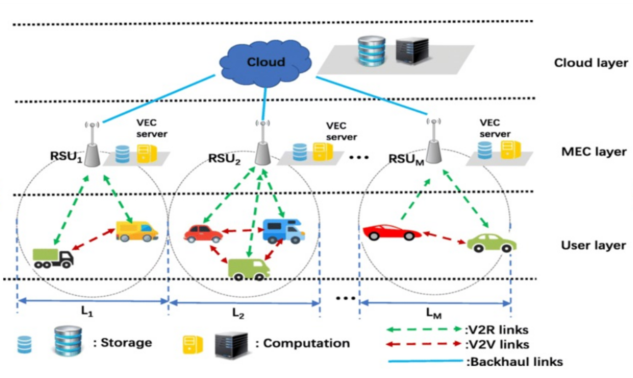

Slide 8

Algorithm
LSTM Based Resource Prediction
Predicts CPU/storage availability in future time slots.
Trained on time-series data from vehicle mobility and past resource usage.
Pareto Optimization
Chooses tasks that jointly minimize processing time and deadline proximity.
Helps in selecting a balanced and cost-effective task set.
Bin Covering Problem (BCP) with FFD Heuristic
Packs selected tasks into VCs with max utilization.
FFD is used for efficient solution: O(n log n).

Slide 9

Plan of Action
Implementation Strategy & Simulation Plan
Model Vehicles, Tasks, and VCs in the simulation.
Each vehicle and RSU in the Vehicular Cloud (VC) sends its current status to the VEC Controller, periodically.
Train and Integrate the LSTM Prediction Model in Python/TensorFlow.
Implement Pareto and Bin Covering-based Scheduler in iFogSim2.
Evaluate with different task arrival rates, deadlines, and mobility patterns

Slide 10
Tools/Framework | Reason for Use
SUMO | Realistic vehicular mobility modeling
iFogSim2 | Supports fog/edge nodes, task scheduling, cost modeling
Python (TensorFlow/Keras) | To train and run the LSTM model
Integration Strategy:
Run SUMO → generate vehicle traces.
Python predicts future CPU and storage availability for each VC.
Feed into iFogSim2 to simulate edge environment.

Slide 11
Tradeoffs
Mobility vs Stability
High mobility enables wider task dissemination, but decreases connection duration and predictability.
Task Deadline Satisfaction vs Resource Utilization
To meet strict deadlines, some tasks may be scheduled to less-loaded VCs, leaving other VCs underutilized.
Cost Efficiency vs Performance
Scheduling on vehicles is cheaper but may have higher delays due to mobility; BSs are more reliable but expensive.
Prediction Accuracy vs Complexity
Using LSTM increases prediction accuracy, but adds ML overhead and needs training data.

Slide 12
Conclusion
MARINA is a novel, efficient task scheduling mechanism for VEC.
Combines resource prediction, deadline awareness, and cost efficiency.
Outperforms state-of-the-art in:
Task scheduling rate (up to 91%),
Monetary cost (reduced by ~80%),
Latency (lower system delay).
Uses a modular hybrid architecture deployable in real-world smart cities.
Offers a scalable, ML-assisted approach for intelligent vehicular ecosystems.

Slide 13

Task
Splitup
Nehan
Karthik
Architecture and Scheduling Logic
Task Modeling &
Metrics
Harish Veylan
Kanish Khan
Simulation Environment & Network Setup
Performance Tuning &
Result Validation

Slide 14

Q/A Time !!

